Slide 1

Note: The data and information in this document is reflective of a hypothetical situation and client. This document is to be used for KPMG Virtual Internship purposes only.
Sprocket Central Pty Ltd
Data analytics approach
[Division Name] - [Engagement Manager], [Senior Consultant], [Junior Consultant]

Slide 2
Note: The data and information in this document is reflective of a hypothetical situation and client. This document is to be used for KPMG Virtual Internship purposes only.
Agenda
Introduction
Data Exploration
Model Development
Interpretation

Slide 3
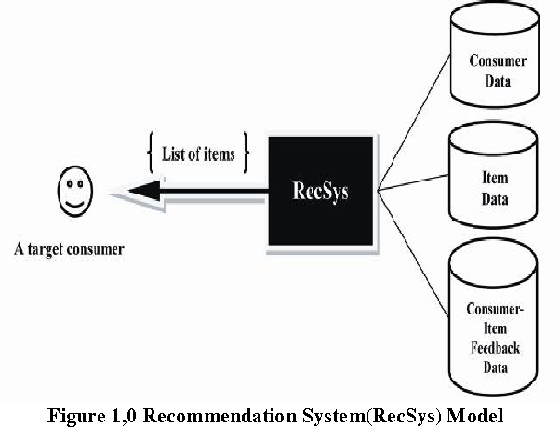
Note: The data and information in this document is reflective of a hypothetical situation and client. This document is to be used for KPMG Virtual Internship purposes only.
Introduction
Objective:- Identifying customers who can add most value to Sprocket Central Pty Ltd.
The presentation entails a detailed plan regarding the development of a recommendation system which can potentially identify the most valued customers for the organisation.
Source – Semantic Scholar (Link)

Slide 4
Note: The data and information in this document is reflective of a hypothetical situation and client. This document is to be used for KPMG Virtual Internship purposes only.
Data Exploration
General steps followed before Data Exploration
Analysed all the 3 datasets provided for missing values.
Made values in columns to be consistent.
Dropped some of the records with more missing values and imputed missing values in the customer demographic dataset for job_title and job_industry_category using the distribution patterns.
Dropped some of the irrelevant columns (which we have thought) that would be making mostly no contribution to the model
Calculation of Age and created Age category column in the customer demographic dataset.
All the datasets are merged together and we have ended with a final dataset with the size 18509*28.

Slide 5
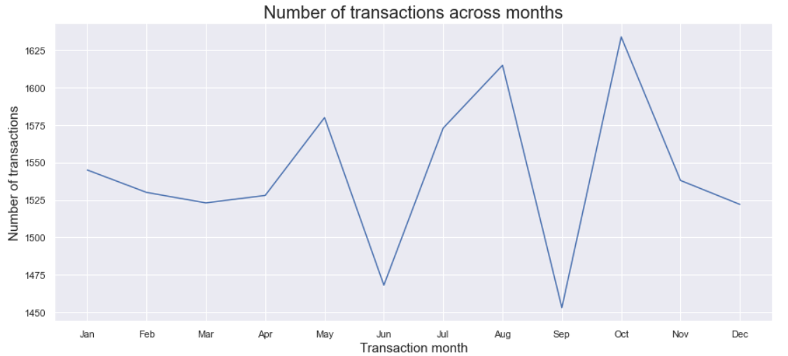
Note: The data and information in this document is reflective of a hypothetical situation and client. This document is to be used for KPMG Virtual Internship purposes only.
Data Exploration (Continued..)
The peaks are the seasons of major transactions and indicates the volume of sales are increasing across the year.
Season of large number of transactions appear to occur in a quarterly fashion.
Transactions in months May, July, August and October constitutes 35% of the overall transactions across the year.

Slide 6
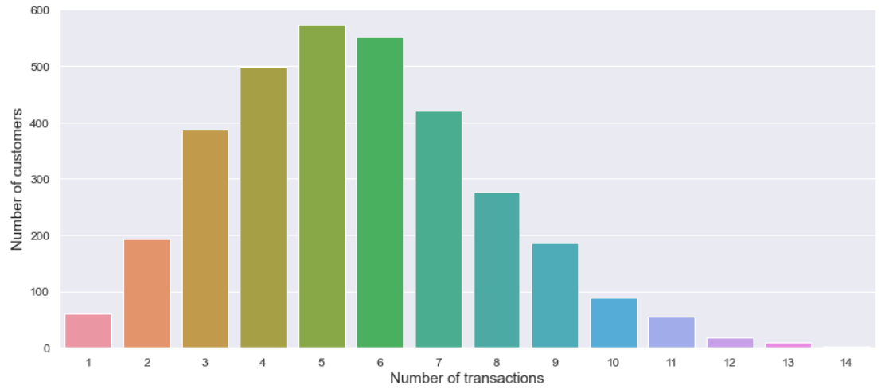
Note: The data and information in this document is reflective of a hypothetical situation and client. This document is to be used for KPMG Virtual Internship purposes only.
Data Exploration (Continued..)
Customers-Transactions Distribution Plot
The graph appears to be following a normal distribution.
Customers making 4 to 7 transactions in a year are making more volume of sales to the organisation.

Slide 7
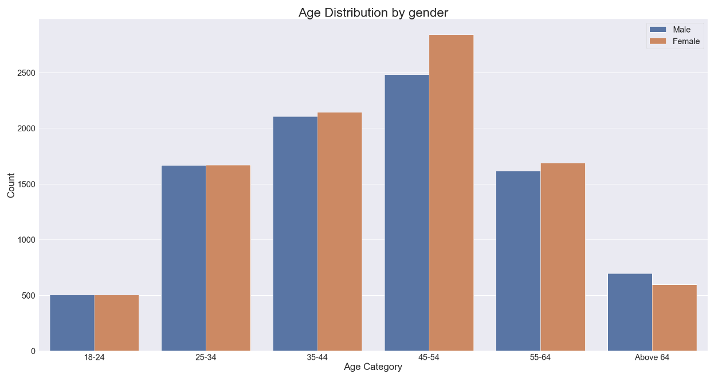
Note: The data and information in this document is reflective of a hypothetical situation and client. This document is to be used for KPMG Virtual Internship purposes only.
Data Exploration (Continued..)
People between the age 35 and 54 make more transactions.
51.7% of the customers are from this age group.
The gender proportion doesn’t seem to cause much of a difference.

Slide 8
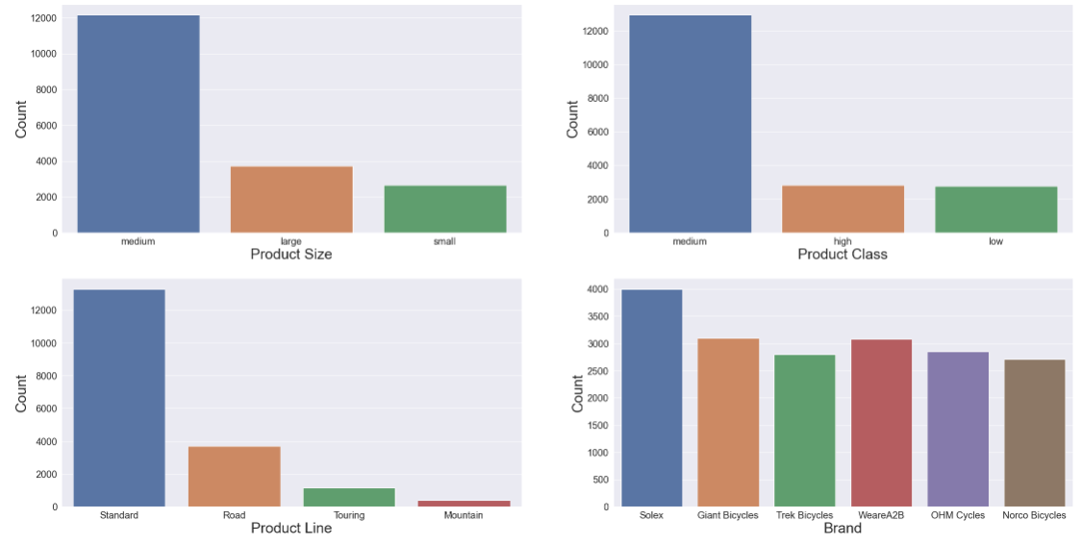
Note: The data and information in this document is reflective of a hypothetical situation and client. This document is to be used for KPMG Virtual Internship purposes only.
Data Exploration (Continued..)
65.6% of the transactions are medium-sized products.
69.8% of transactions are in the medium product class.
71.7% of purchases are part of the standard product line.
Solex is the most sought brand by customers.

Slide 9
Note: The data and information in this document is reflective of a hypothetical situation and client. This document is to be used for KPMG Virtual Internship purposes only.
Model Development
Approach
Vectorization of the relevant features are done based on the distribution.
Values are summed up for each customer.
K-means clustering algorithm to categorize customers.
Based on the number of transactions and amount spent the customer clusters are ranked.
Decision tree model is fitted for the existing data and accuracy in predicting the categories come to 70%.
The classification model is used to categorize the new 1000 customers.

Slide 10
Note: The data and information in this document is reflective of a hypothetical situation and client. This document is to be used for KPMG Virtual Internship purposes only.
Model Development (Continued..)
Feature Selection
Done using WEKA.
CfsSubsetEval with GreedyStepwise was used for identifying the relevant features
Selected features are customer_id, gender, job_title, job_industry_category, wealth_segment, tenure, postcode, state, property_valuation, Age, past_3_years_bike_related_purchases

Slide 11
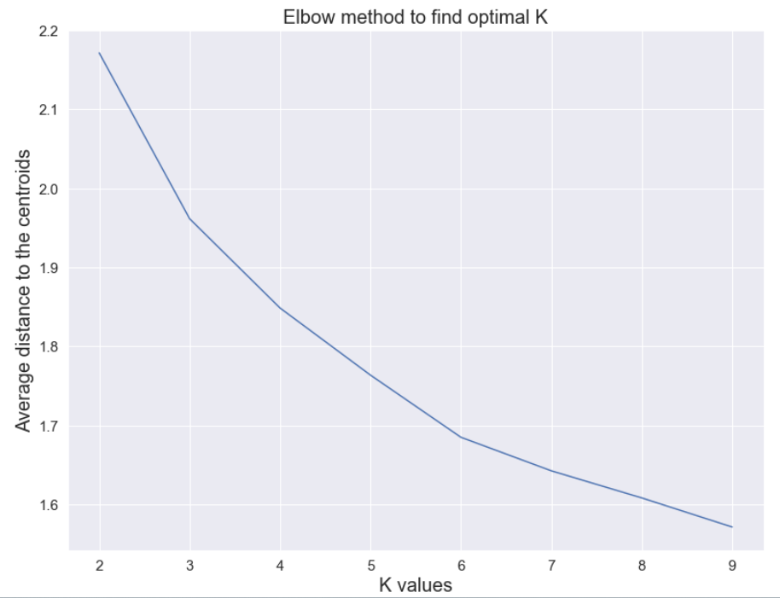
Note: The data and information in this document is reflective of a hypothetical situation and client. This document is to be used for KPMG Virtual Internship purposes only.
Model Development (Continued..)
Vectorization and K-means algorithm to identify customer clusters
Values are all vectorized based on distributions.
Fit K-means clustering model.
Using elbow method, the optimum number of clusters is found to be 3 based on which the marketing strategy has to be focussed.

Slide 12
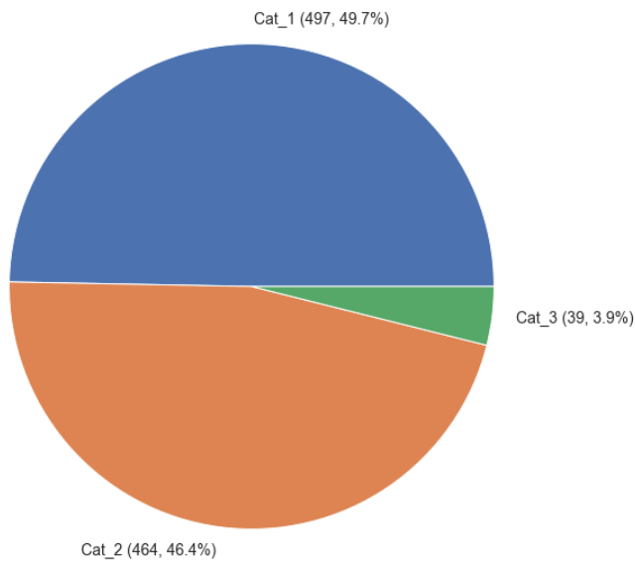
Note: The data and information in this document is reflective of a hypothetical situation and client. This document is to be used for KPMG Virtual Internship purposes only.
Model Development (Continued..)
New customer classification with decision tree model.
The decision tree model was giving an accuracy of 70% for customer classification.
Customers belonging to category 1 need to be focussed more and then followed by category 2 and category 3.

Slide 13
Note: The data and information in this document is reflective of a hypothetical situation and client. This document is to be used for KPMG Virtual Internship purposes only.
Interpretation
The key points in identifying critical customers for the organisation were the number of transactions and the total value of the items purchased by the customers.
In the predictions, category 1 and category 2 were the most and the system suggests that category 1 customers will be making more value to the organisation.
Customers in category 3 are mostly whom we have many missing information or based on the model prediction they can make lesser value to the organisation compared to the other two categories.

Slide 14
Note: The data and information in this document is reflective of a hypothetical situation and client. This document is to be used for KPMG Virtual Internship purposes only.
Thank You

